Slide 1
NEW YORK TAXI TRIP DURATION
BY- ROANEK JEAN

Slide 2
AGENDA
DATA LOADING
DATA EXPLORATION
DATA CLEANING
FEATURE SELECTION
DATA VISUALIZATION
DATA SPLITTING
TRAINING MODEL
TESTING THE MODEL

Slide 3
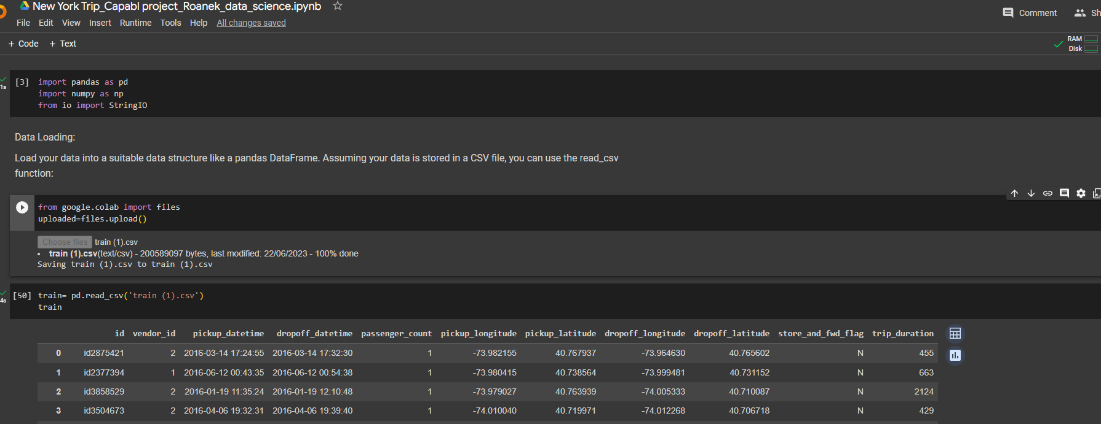
DATA LOADING
Load your data into a suitable data structure like a pandas DataFrame. Assuming your data is stored in a CSV file, you can use the read_csv function:

Slide 4
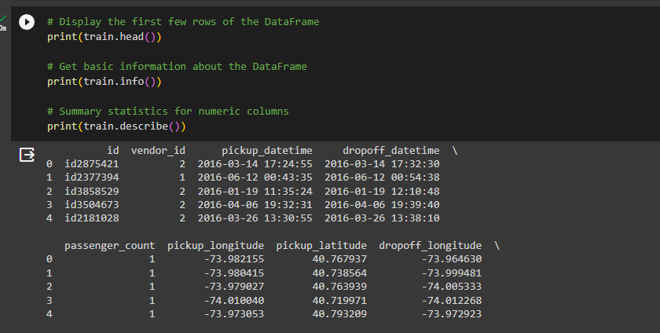
DATA EXPLORATION
Explore your data to understand its structure and identify any missing values or anomalies. You can use functions like head(), info(), and describe():

Slide 5
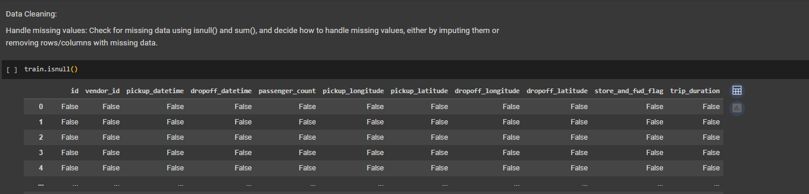
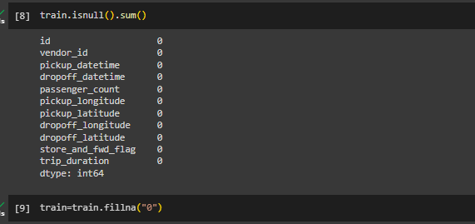
DATA CLEANING and FEATURE SELECTION
Handle missing values: Check for missing data using isnull() and sum(), and decide how to handle missing values, either by imputing them or removing rows/columns with missing data.

Slide 6
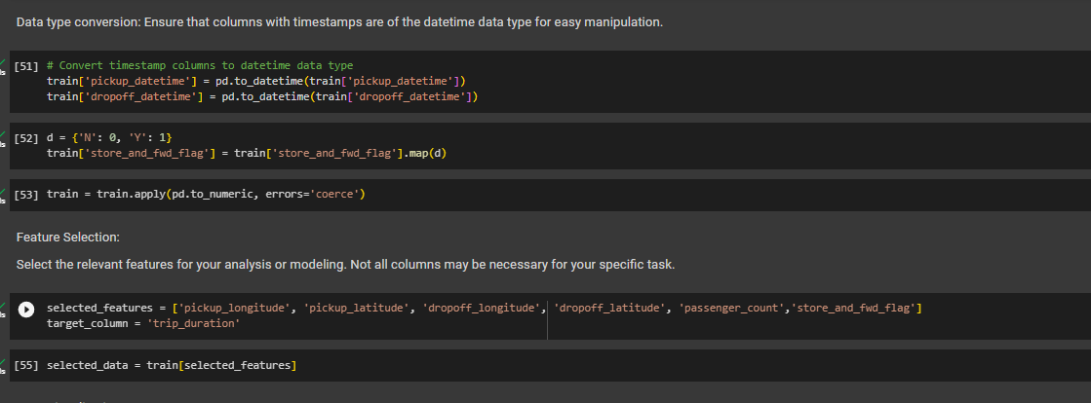
Data type conversion: Ensure that columns with timestamps are of the datetime data type for easy manipulation.
This column contains categorical data (e.g., "Y" or "N"), you can convert it to numeric values (e.g., 1 for "Y" and 0 for "N") using encoding techniques such as one-hot encoding or label encoding. However, for linear regression, it's often better to drop or exclude categorical columns, as linear regression assumes numerical features.

Slide 7
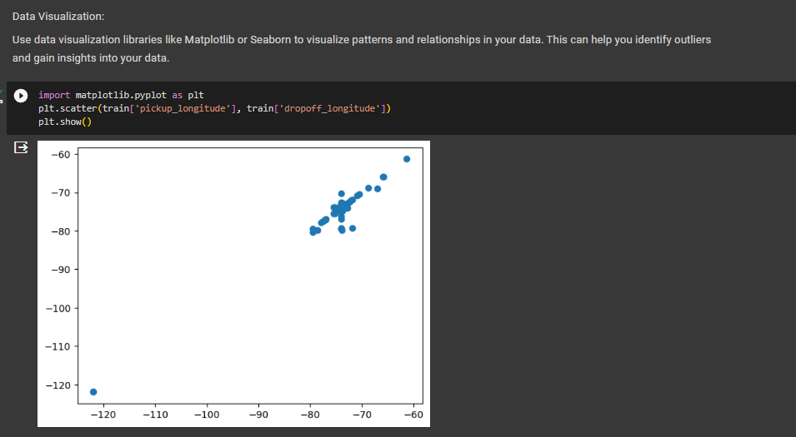
DATA VISUALIZATION
Use data visualization libraries like Matplotlib or Seaborn to visualize patterns and relationships in your data. This can help you identify outliers and gain insights into your data.

Slide 8
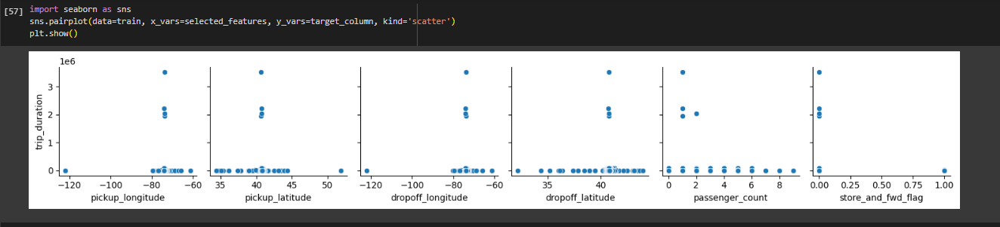
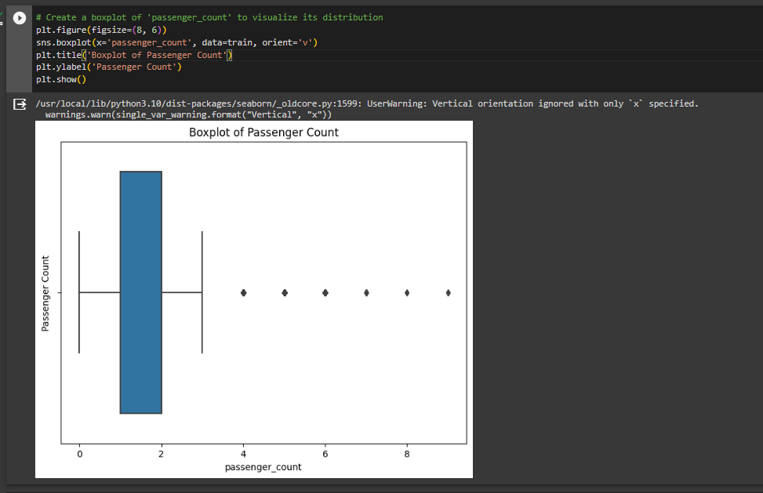
Using the seaborn and matplotlib library to plot the graphs

Slide 9
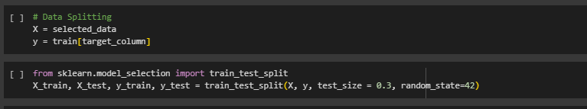
DATA SPLITTING and TRAINING MODEL
If you're building a predictive model, split your data into training and testing sets to evaluate model performance.
Splitting the data into 70:30 train test split.

Slide 10
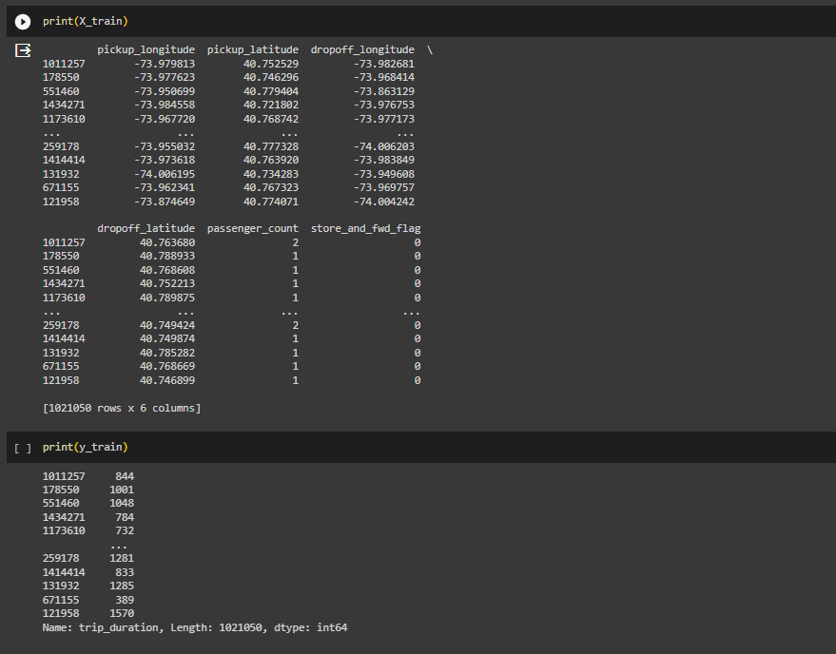
Printing the training dataset for x and y side

Slide 11
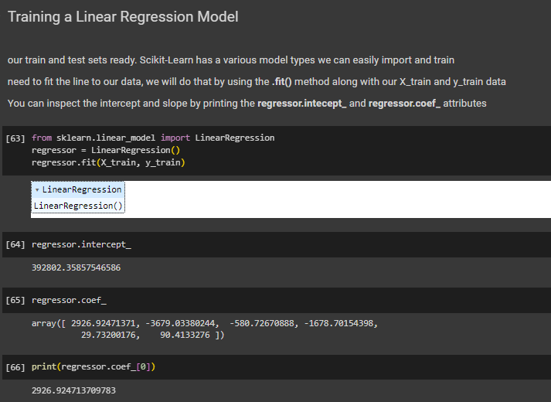
Simple Linear Regression
Simple linear regression is a statistical method that allows us to summarize and study relationships between two continuous (quantitative) variables: One variable, denoted x , is regarded as the predictor, explanatory, or independent variable. The other variable, denoted y, is regarded as the response, outcome, or dependent variable.

Slide 12
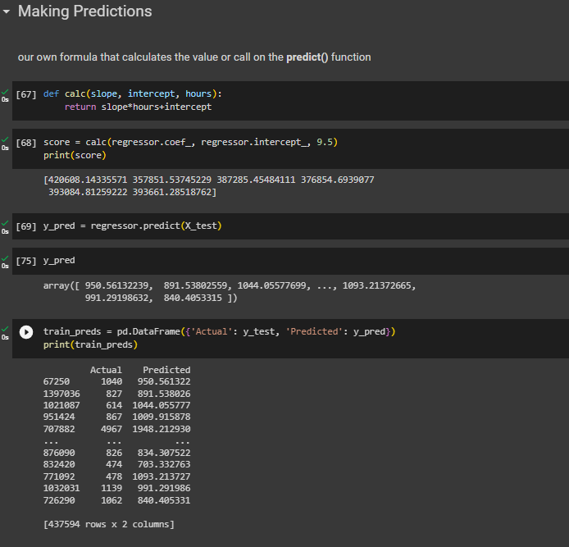
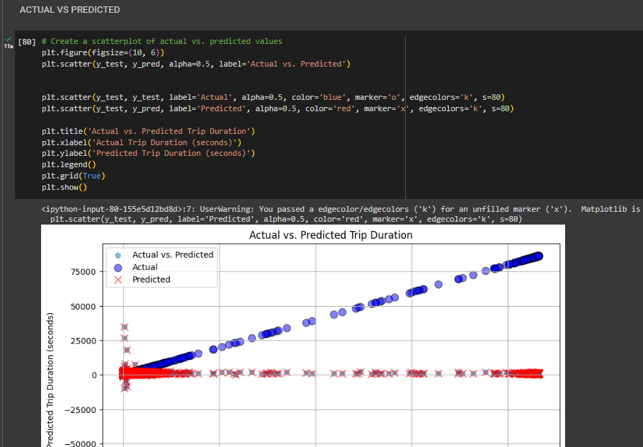
Predicting trip duration
There is a difference between the actual and predicted data

Slide 13
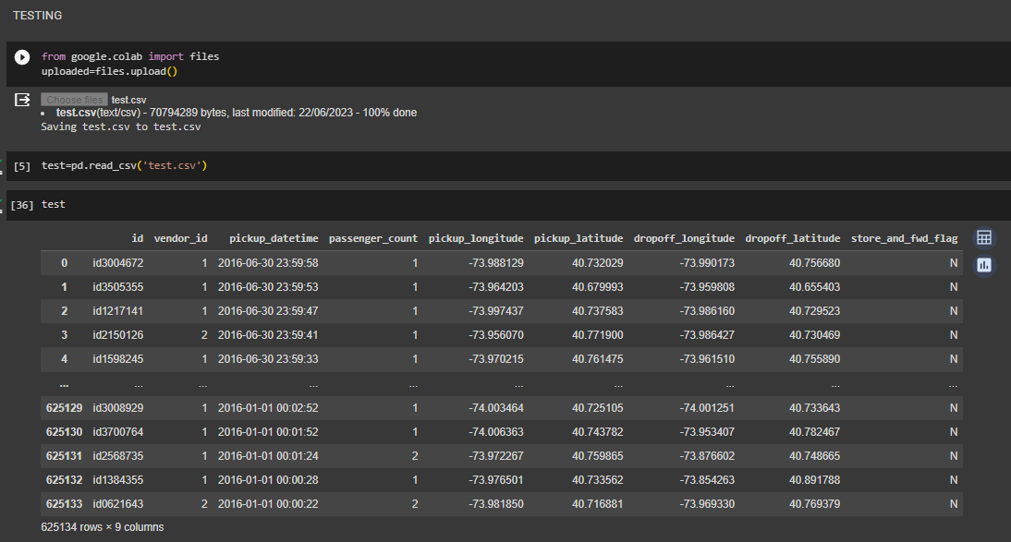
TESTING THE MODEL
To test your linear regression model, we typically use a separate dataset, often referred to as a "test set" or "validation set," that the model has not seen during training. This allows us to evaluate how well the model generalizes to new, unseen data.

Slide 14
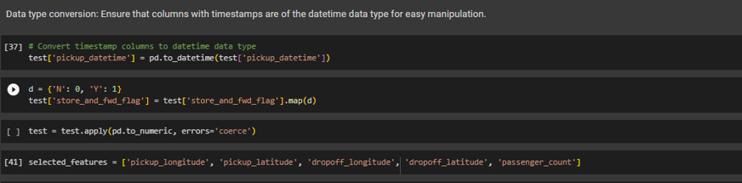
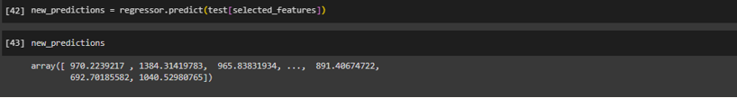
Preprocess the data and predict the trip duration
Prepare the New Data: Ensuring that my new data is in the same format as the data I used to train my model. This means that it should have the same features (columns) and be preprocessed in the same way.
RESULT

Slide 15
THE PDF AND IPNYB FILE IS GIVEN BELOW
NYC TRIP DURATION_Roanek- Capabl project

Slide 16
THANK YOU
Roanek Jena

